Slide 1
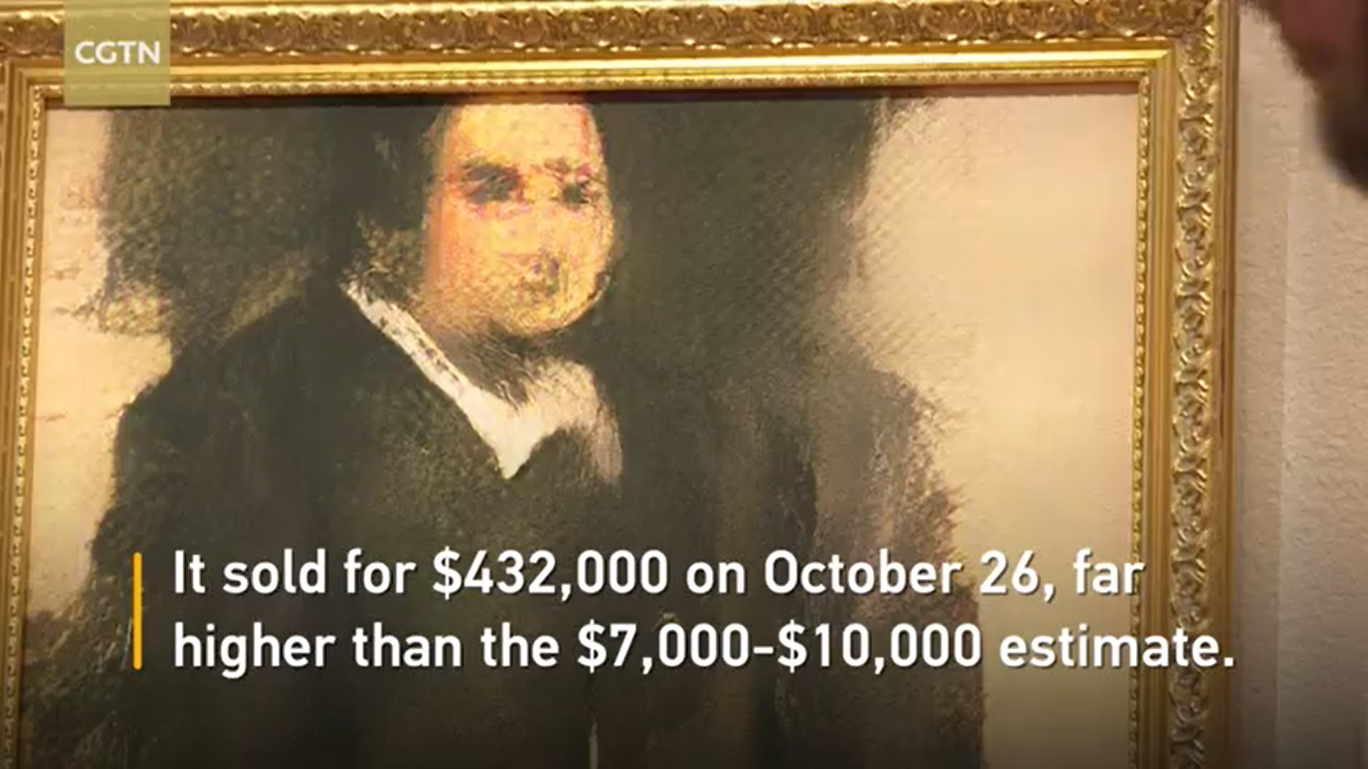

Slide 2
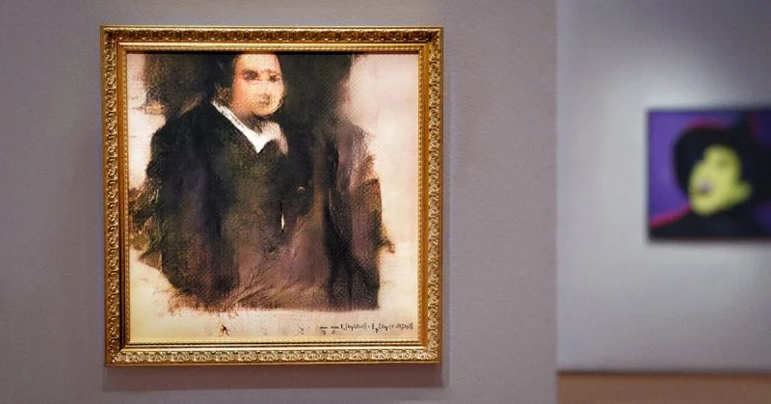
Is it ART?
What are the implications for the art world?

Slide 3
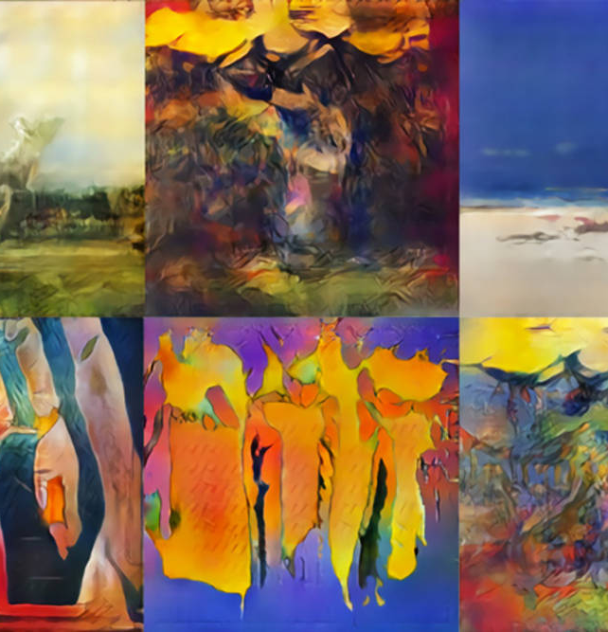
CHALLENGE
Paintings from WikiArt (the Visual Art Encyclopedia)
Half of the images in this data set are fake paintings which were generated through Generative Adversarial Network.
Object: detect the fake paintings from true, authentic images

Slide 4


TASK
Classification binaire
Peinture générée
Vraie peinture

Slide 5
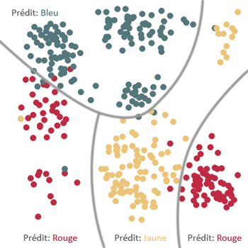
TASK
Apprentissage supervisé

Slide 6
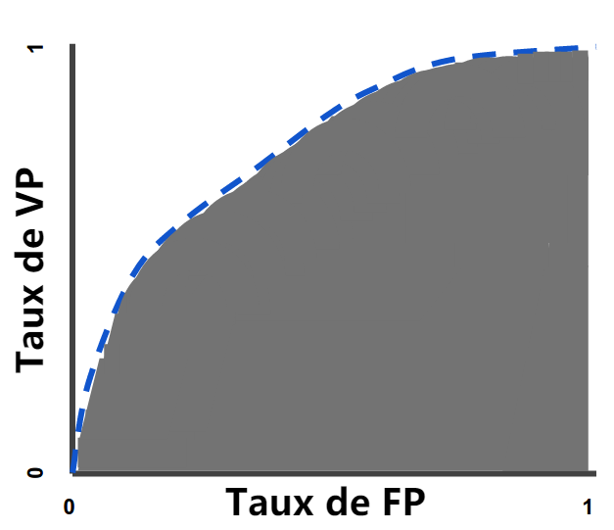
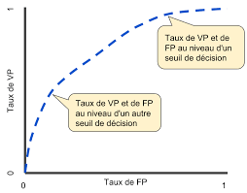
Métrique: ROC et Modèle PCA
Notes:
https://developers.google.com/machine-learning/crash-course/classification/roc-and-auc?hl=fr

Slide 7
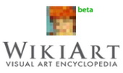
DATA

Slide 8
GAN
Generative Adversarial Network

Slide 9
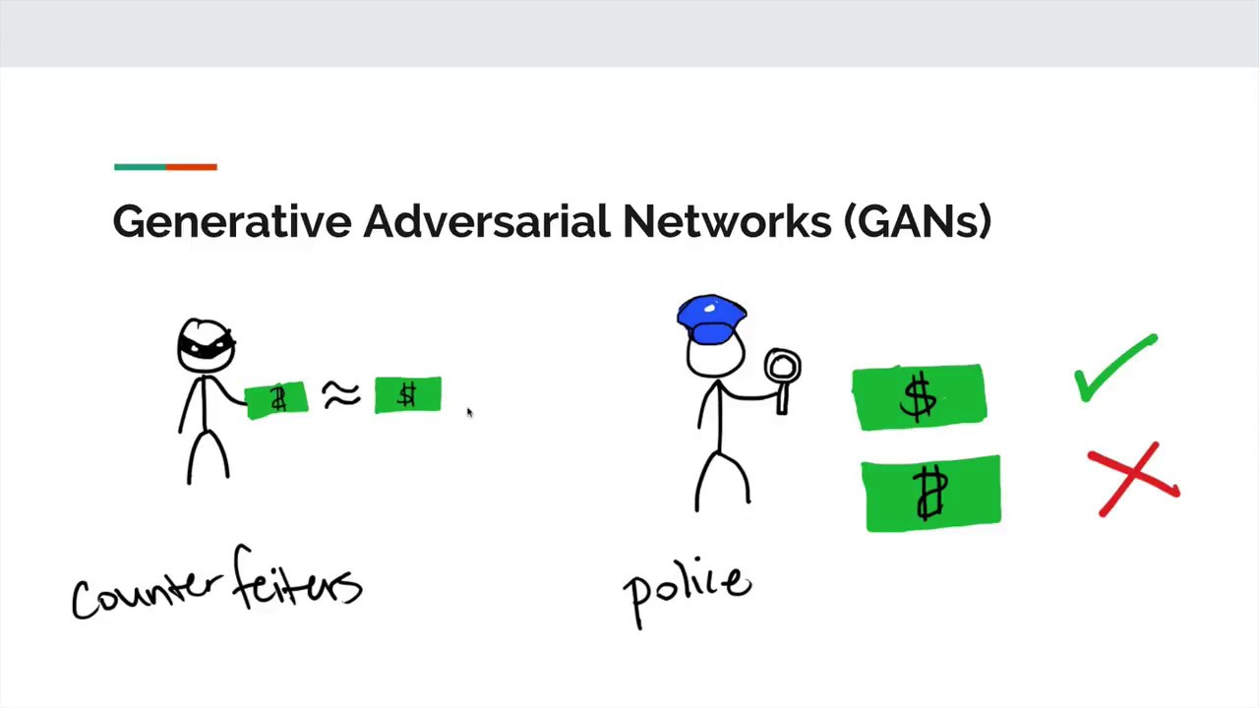
Notes:
https://www.google.com/search?q=Generative+Adversarial+Network&rlz=1C1CHZL_zh-CNFR706FR706&tbm=isch&source=iu&ictx=1&fir=KFkMoB0T6kbSrM%253A%252CI2N4ZS7t2K2sRM%252C%252Fg%252F11cmqkkd8d&vet=1&usg=AI4_-kRl_lLfKdxcYTi4t4T6_FAJ_GwCWg&sa=X&ved=2ahUKEwiHpIP3rpjhAhUGCxoKHc60A2QQ_h0wEnoECAwQDA#imgrc=tG013KzarCqAQM:&vet=1

Slide 10
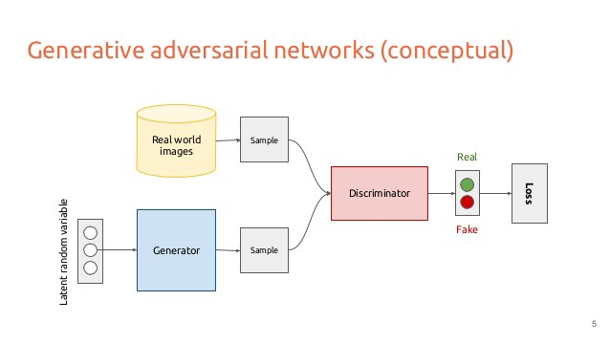

Slide 11
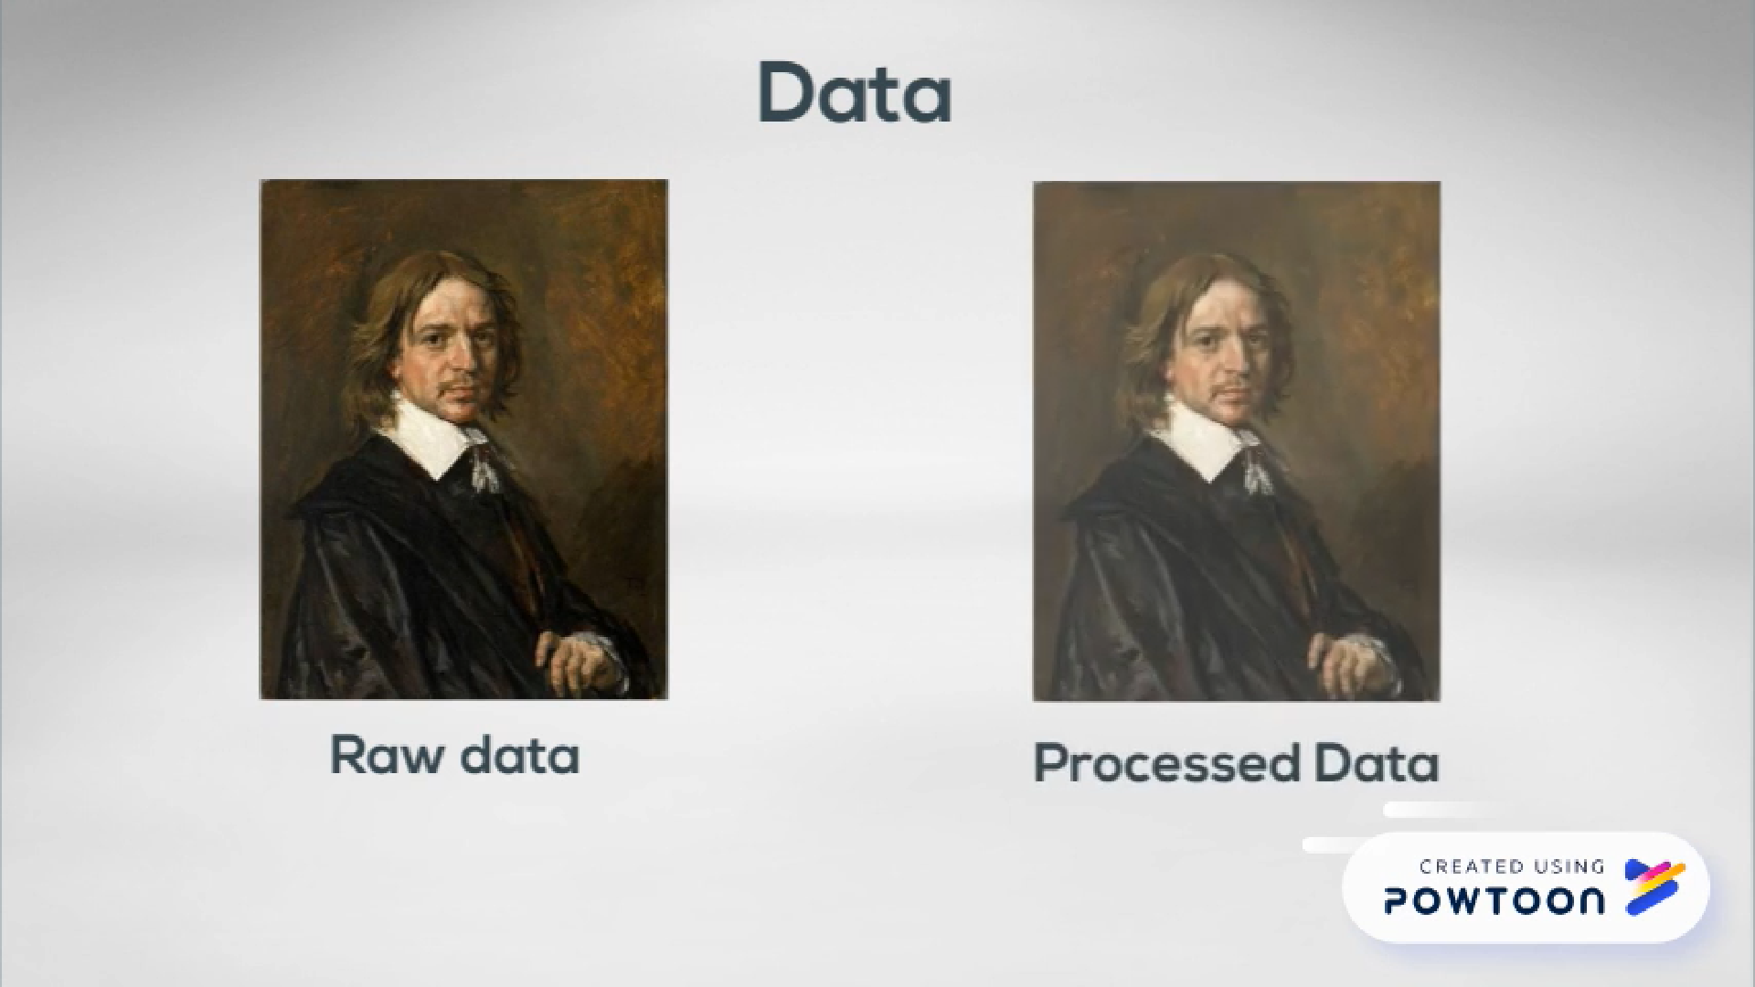
Row data VS Processed data

Slide 12
Preprocessing
an image of dimension 64*64*3 is preprocessed as a vector of 1*200 where we extract 200 principal components (PCA) of the image
1
64
200
3
64

Slide 13
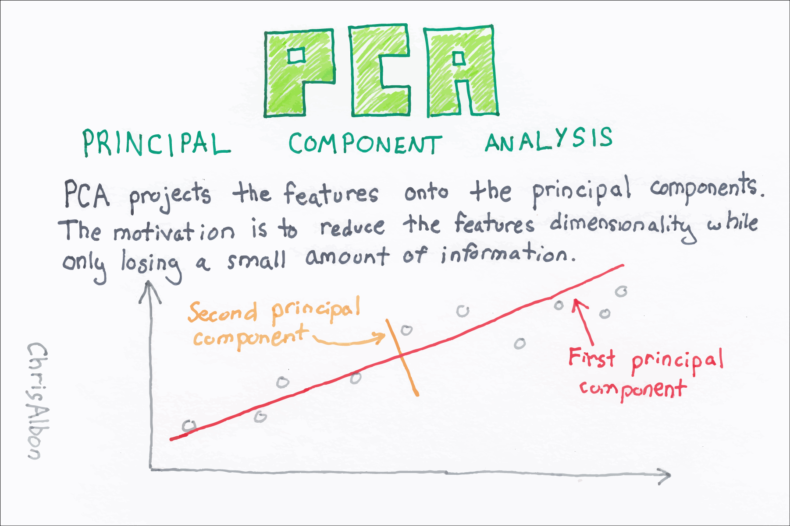

Slide 14



Slide 15

TEAM MONET

